Slide 1
DriverPass System Analysis
Isaiah Bryant
Notes:
[No speaker notes required for this slide.]

Slide 2
System Requirements
Functional requirements
The system shall provide a method for purchasing a package
The system shall have a role-based logon process
The system will allow for the student to complete practice test online
The system will allow students and staff to enroll students into the courses in the packages purchased
To reduce admin backlog users will have an automated process to regain their account If credentials are forgotten
Nonfunctional requirements
The application will be web-based and cloud hosted
The application will have https encryption for data transfers
The system will host multiple users simultaneously
No data changes will be allowed offline
All changes will be tracked for the admin to generate a report
Notes:
The functional requirements such as purchasing a package, logging on, completing practice test, enrolling in course times, and resseting account info were requested by the DriverPass team. These are the desired functions of the application. While the nonfunctional requirements allow the application to be sustainable, scalable, secure, and reduce overhead cost.

Slide 3
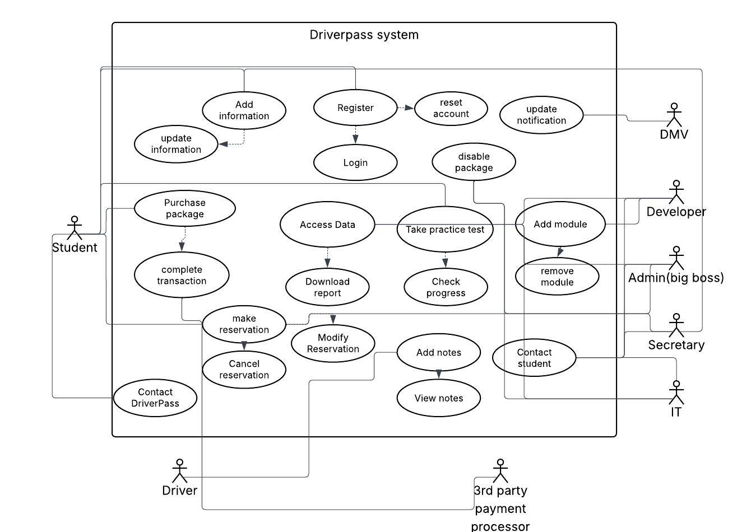
Use Case Diagram
Notes:
Student, Driver, Dmv, Developer, Admin, Secretary, IT, and the payment Processor are the actors of the DriverPass system. The main use cases of the application include purchasing packages and registering. While other use cases such as adding information or completing a transaction support these use cases.

Slide 4

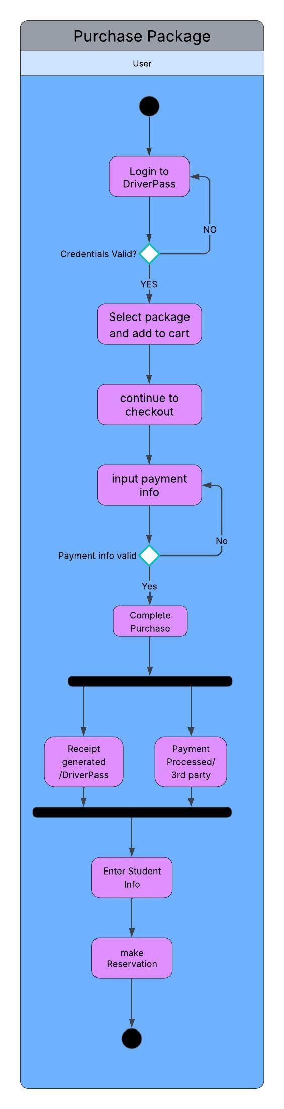
Activity Diagram
Notes:
This diagram demonstrates the sequence in which the user will purchase a package. The user will begin logging in then proceed to select which package is wanted adding it into their cart. Once the user has the packages wanted they will check out. If the payment info is valid and funds are sufficient the receipt is generated and the payment is processed by the third party. This then prompts the user to proceed to the next use case which is registering for the package bought.

Slide 5
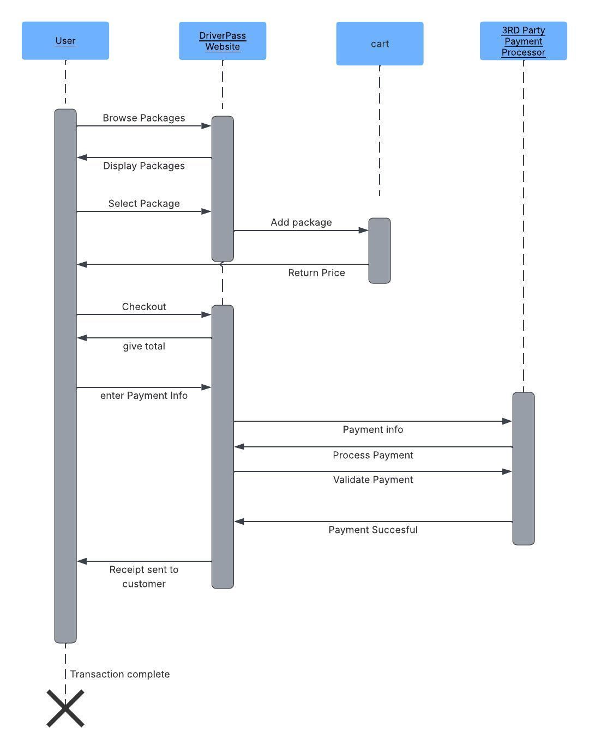
Sequence Diagram
Notes:
This diagram represents the order and information exchange during the process of purchasing a package using the DriverPass system. The package is added into the cart through the user selecting the package from the website then the website adds it into the users cart. The cart returns the price and the user proceeds to checkout with the website. The total is given to the user and payment information is sent to the processor in which the notifies the system once successful. The system then generates the customer their receipt.

Slide 6
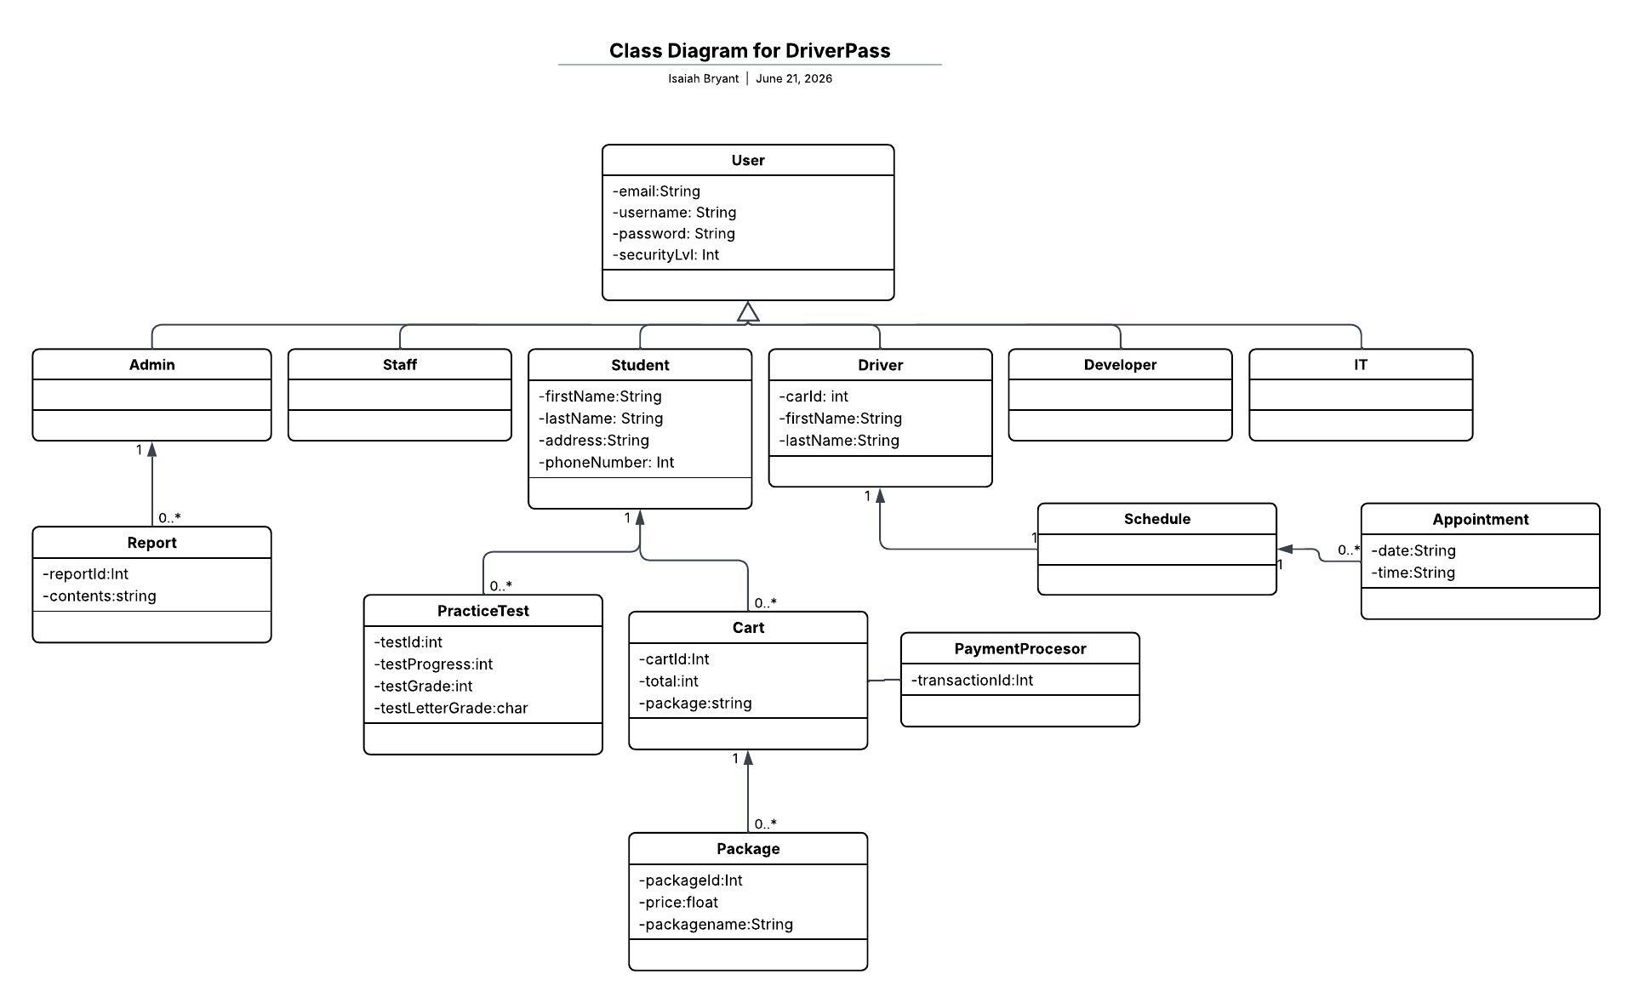
Entities of the system and only attributes
Notes:
This class Uml represents the entities and design of the system and their attributes. The functions of the attributes will be added in development. As demonstrated here in the UML the Users all have login attributes. While entities like student and driver gain specific attributes such as name, info, etc.

Slide 7
Security
Data will be encrypted using https transfers
Cloud based data storage enables secure storage of data
Role based access control inhibits users from accessing unauthorized data
Payments will be handled by third party who will handle security of users payment information
Key pairs will be used to encrypt system data
Rate limiting will reduce vulnerability to brute force attacks
Notes:
Most security will come from the outside. Data will be hosted by a cloud vendor and the application will rely on their security. The users will be given permission as to which activities they can perform. Payments will be handled by an outside vendor. Again most security is outsourced to fit the business time frame and reduce overhead.

Slide 8
System Limitations
User device is current enough to run web based applications
Internet connection maintained to support the online functionality
Native based mobile applications
Changes to packages must be performed by a developer
Third party dependent for data storage, web host, and transaction processing
Scalable to support student onboarding
System is beginning with 10 drivers
Notes:
The limitations are built into the system design. A web hosted application is dependent on the users and their devices. Reducing the overhead for hosting, data storage, and payments make the application limited and reliant upon these third parties. Package changed require technical knowledge and are limited to developers.

